Slide 1
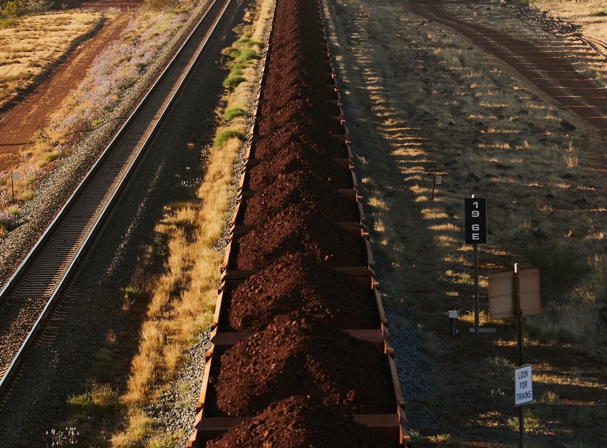
IPI
Australia
Practical Conveyor Optimisation Capability

Slide 2
Please note that this document is intended to be viewed as a presentation

Slide 3
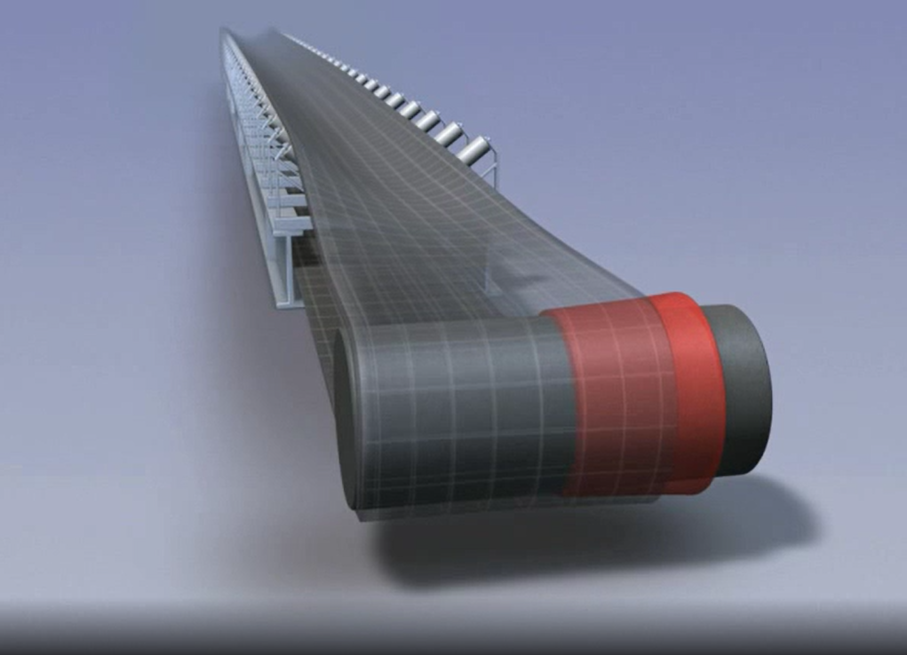
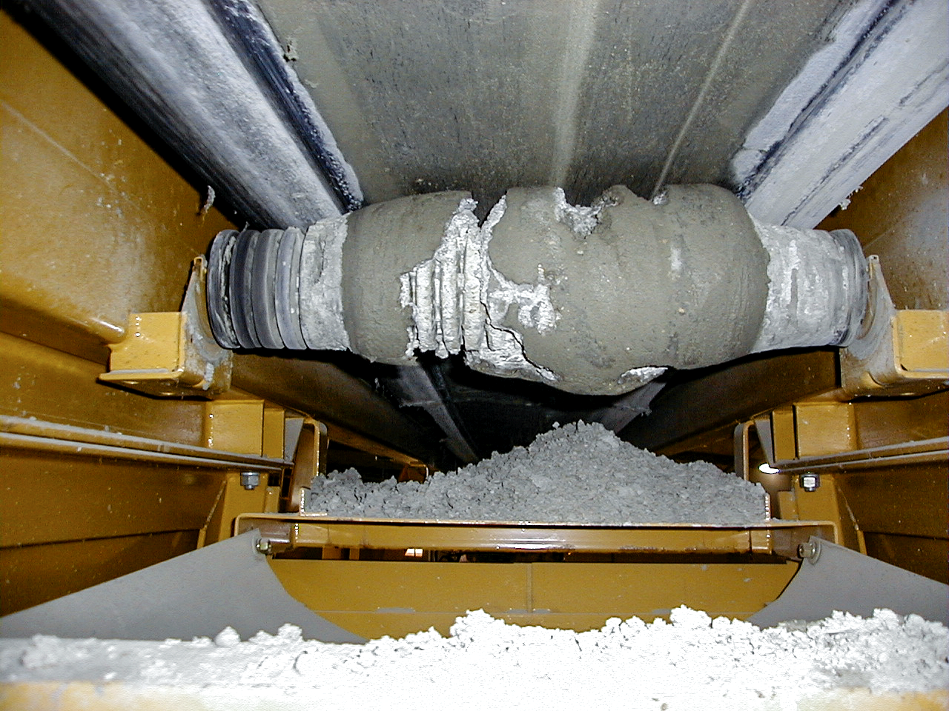
Being able to adjust an offline conveyor inside a short plant shutdown and know with confidence that it will operate as desired on restart – no further downtime necessary – is now less a luxury and more a necessity.
This used to be acceptable, but with ever increasing production demands the time lost to trial and error tracking methodology wears very thin with under-pressure operations managers.
The reality is that the people usually tasked with addressing conveyor belt tracking issues would have difficulty answering these questions. This is often because conveyor belt tracking is treated as an artform open to interpretation and experience, not a science where principles are applied and weighted to produce a predictable outcome.
Let’s start with a question…
If conveyor belts always track to the “high side”, why does this belt track to the left,
When this belt clearly tracks to the right?
And why would water between the working surfaces likely make this situation worse,
But this situation better?

Slide 4
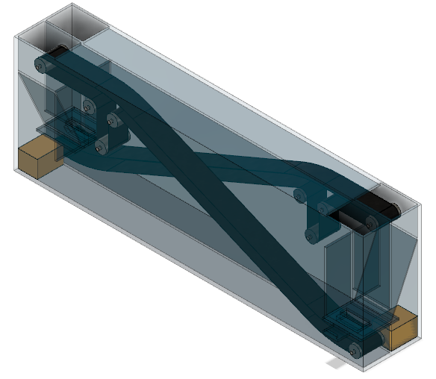
Our Training Approach
Coupling extensive conveyor installation, commissioning and operations experience with application specific engineering principles, the team at IPI can educate your personnel in methodology proven to result in predictable conveyor performance following multiple component changes in an outage. Your exposure to unknown or unintended consequences can be controlled as rigidly as your risk profile allows.
IPI doesn’t simply teach from a slide-pack; our miniaturised conveyor system allows students to interact with an array of belt tracking scenarios in a zero risk environment. By being able to test the limits of component functionality, it is our observation that students develop and retain a more complete understanding of conveyor belt tracking principles.

Slide 5
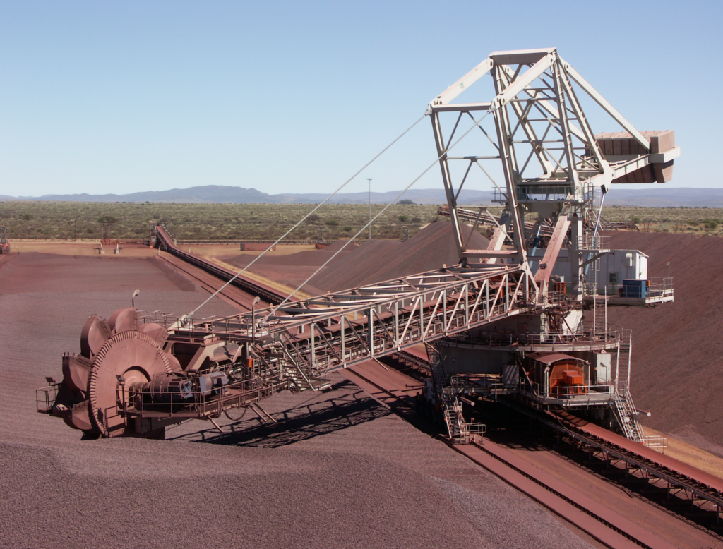
Post-course, IPI’s proprietary application Belt TrackerHackerTM*, guides trouble shooting and decision making to ensure that students continue to apply their newfound knowledge correctly in the field
Continued Service
and
Support
IPI TrackerHackerTM V0.10
Issue Location Selection
Issues Observed
Belt Tracks to LHS Unloaded
Belt Tracks to RHS Unloaded
Belt Tracks to LHS Loaded
Belt Tracks to RHS Loaded
Belt Tracks LHS to RHS Unloaded
Belt Tracks RHS to LHS Unloaded
Belt Tracks LHS to RHS Loaded
Continue
*Under alpha testing at time of writing

Slide 6
IPI TrackerHackerTM V0.10
IPI TrackerHackerTM V0.10
IPI TrackerHackerTM V0.10
IPI TrackerHackerTM V0.10
IPI TrackerHackerTM V0.10
IPI
Belt TrackerHackerTM
Issue Location Selection
Suspected Causes
Pre-Feed Presentation
Post-Feed Presentation
Belt Damage (Single Instance)
Belt Damage (Multiple Instance)
Carry Roller Build-Up
Frame Damage (Single Instance)
Frame Damage (Multiple Instance)
Frame Misalignment
(Single Instance)
Frame Misalignment
(Multiple Instance)
Preliminary Actions
- Estimate the net effect of the
damaged frames on belt
behaviour (e.g. does one frame
arm angle forward more
aggressively than the other)?
- Does the expected effect align
with your observations (e.g. is the
belt mistracking more severely
than you would have thought)?
- Do rollers installed in these frames regularly fail?
Issues Observed
Belt Tracks to LHS Unloaded
Belt Tracks to RHS Unloaded
Belt Tracks to LHS Loaded
Belt Tracks to RHS Loaded
Belt Tracks LHS to RHS Unloaded
Belt Tracks RHS to LHS Unloaded
Belt Tracks LHS to RHS Loaded
Username
Password
Conveyor Selection
Continue
Continue
Continue

Slide 7
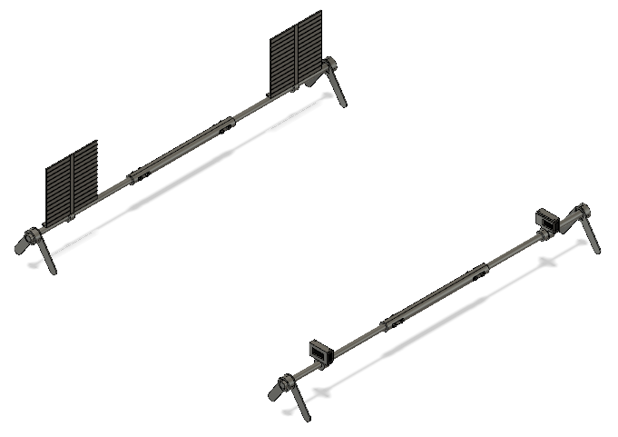
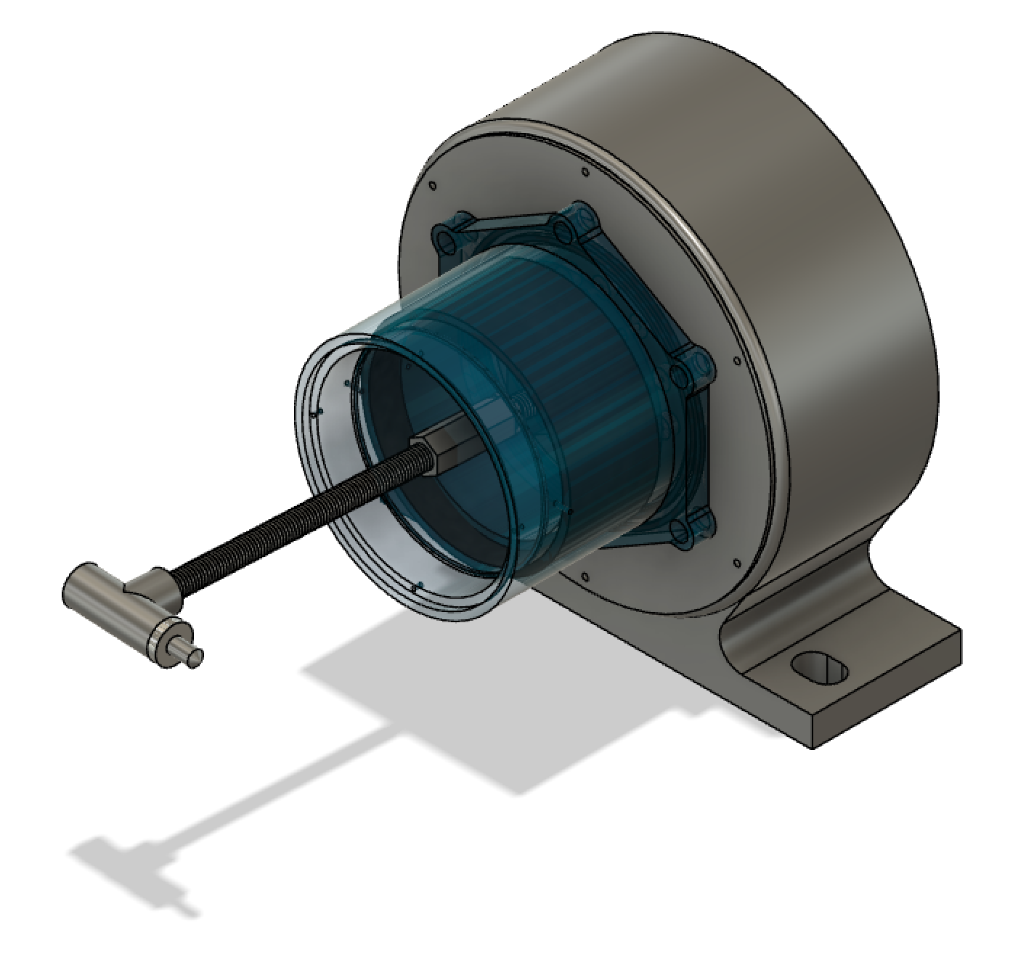
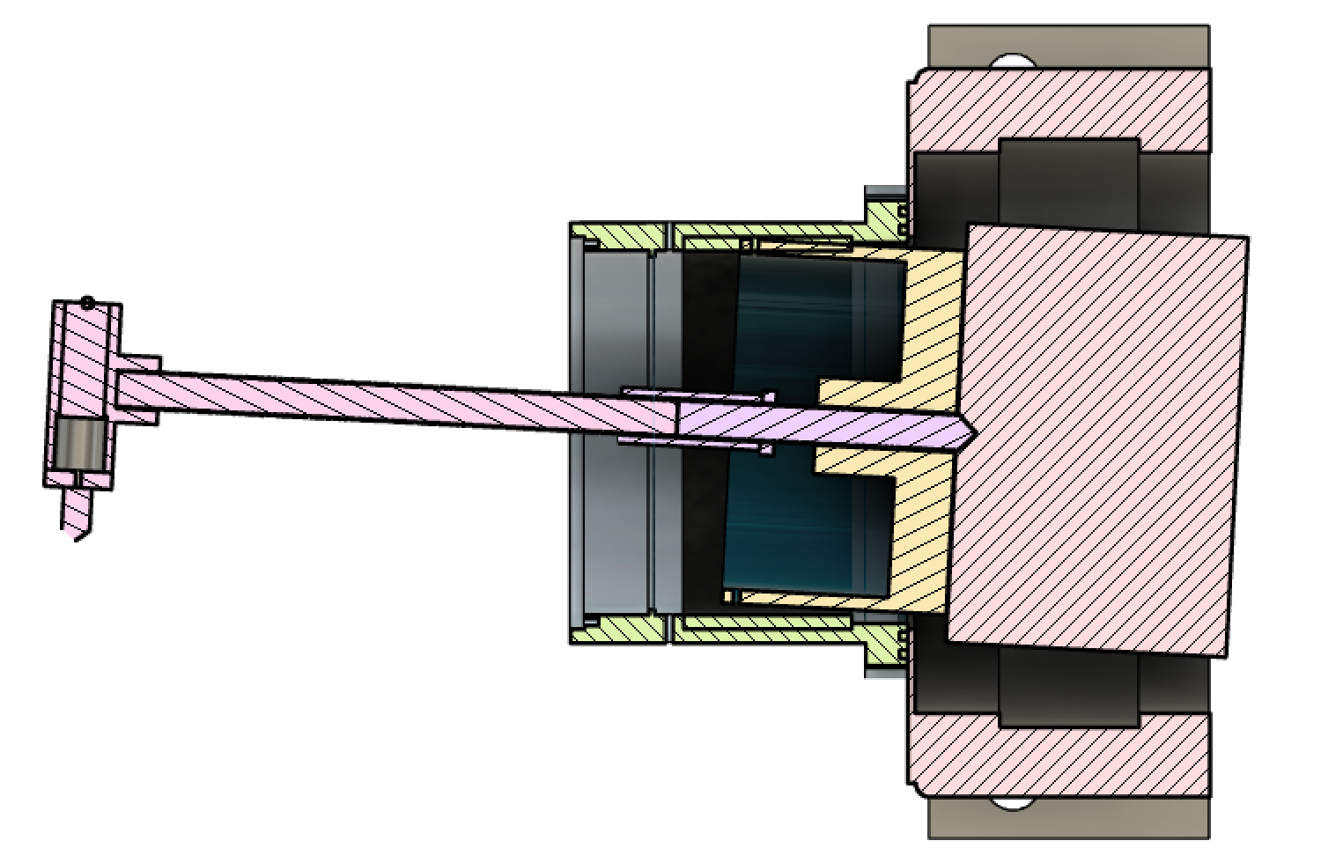
Importantly, we are agnostic to differing brands and solutions.
Because we don’t seek to sell products and we do not accept arrangements with solution manufacturers, we will only ever nominate the best solution for the application; balancing cost, maintainability and performance.
We are in the business of integrity. It’s what sets us apart and we do not compromise on it.
Solution Development
Site attendance for problem analysis (using proprietary tools such as the IPI Shaft Alignment System (SAS), multi-purpose Conveyor Component Alignment Tool (CCAT) and Mobile Camera Platform
Engineering design review (specifically for minor works to minimse poor belt tracking characteristics)
Pre-installation solution function modelling
Prototyping and testing of solutions
Level 2 Engineer Training (minimum requirements)
Tertiary level engineering qualifications (ideally Mechanical or Mechatronic)
Basic conveyor component design and operating knowledge
Due to training content being more theoretical in nature, participants do not require extensive prior experience with conveyors
Level 2 Engineer Training (additional to Level 1)
Deconstruction of belt tracking forces,
Calculation methods for competing forces,
Tracking solution engineering principles and limitations,
Tracking solution selection and specification (based on engineering calculations),
Prediction of belt behaviour post intervention (based on engineering calculations)
Level 1 Technician Training (minimum requirements)
Mechanical trade level or conveyor specific qualifications (inc. Cert IV in Polymer Technology)
3 years direct experience with operating conveyors
Training content is designed to build on a participant’s existing familiarity with the behaviour of an operating conveyor. For this reason, reasonable opportunity to have interacted with operating conveyors is preferred
Level 1 Technician Training
Detailed explanation and coaching of belt tracking forces,
Identifying sources of competing forces,
Determining force dominance,
Best practice adjustment and alignment methods (including pulleys)
Tracking solution operating principles and limitations,
Tracking solution selection and specification,
Prediction of belt behaviour post intervention
Our Conveyor Services:
Engineering Support
Training
Instrument Tool
IPI SAS
IPI CCAT
IPI CCAT

Slide 8
A quantified engineering approach to conveyor belt tracking is a niche discipline, but at IPI, niche is what we do.
And we look forward to any opportunity to share our highly specialised skills with you to achieve a step change in your operating performance.
IPI
Australia

